Slide 1
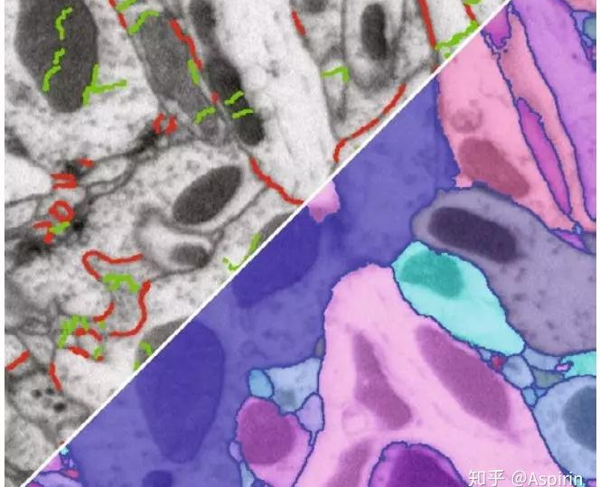

Ilastik – The Interactive Learning And Segmentation Toolkit
From Pixel Classification To Boundary-based Segmentation Of 3D Volumes

Slide 2
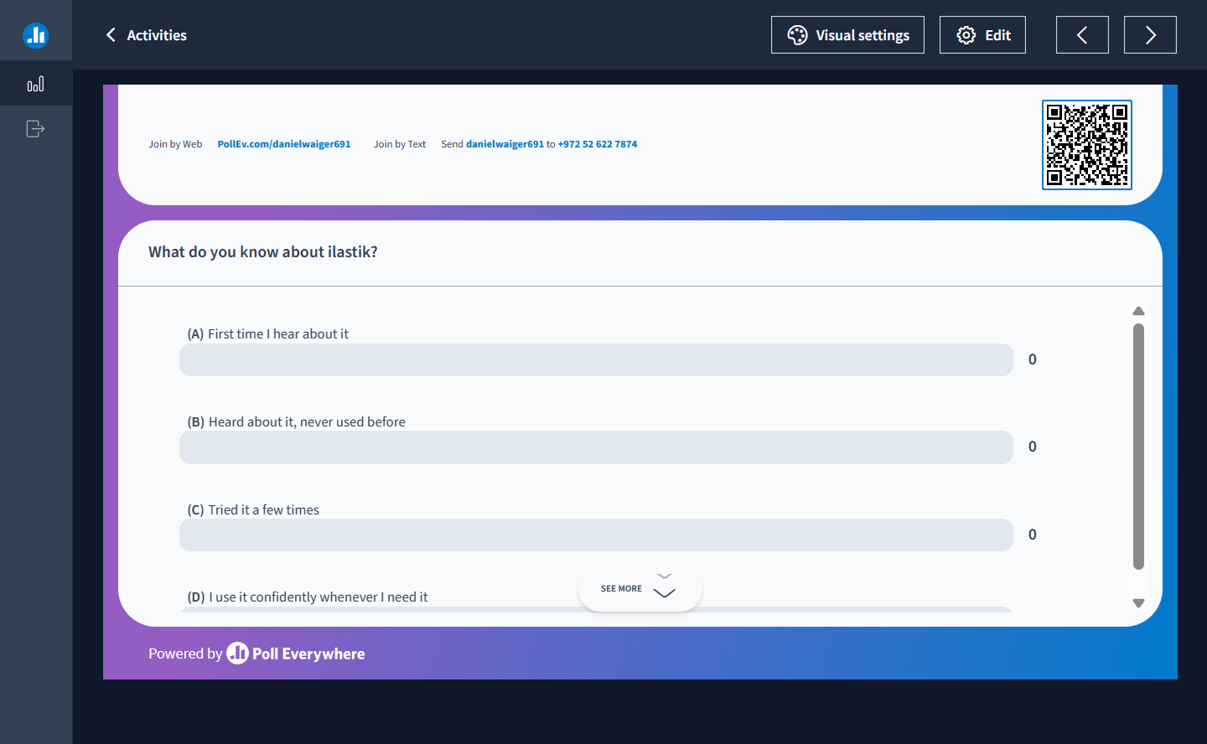

Slide 3
What’s ilastik, and what is it for?
{Quick Disclaimer}
For every topic in this slide there is a great documentation page on www.ilastik.org. If a topic is still unclear after this session, feel free to ask me, the website, and above all, the amazing image science forum: Image.sc Forum where everybody is welcome to ask questions from the most basic ones to more advanced questions.

Slide 4
What’s ilastik, and what is it for?
An interactive (user-supervised) segmentation toolkit that uses ML to classify pixels (and objects) into separate classes.
It has a clean GUI that allows the user to follow relatively simple instructions to train a pixel classifier to detect classes of interest vs. background.
The output(s) of the main workflow, pixel classification, can be used in other ilastik workflows, or in other tools like Fiji, Napari, ICY, and code-based workflows like python.
Above all, ilastik aims to solve the issue(s) of classical image processing, when simple processing (like filtering and thresholding) can’t provide good-enough detections of the signal of interest.

Slide 5
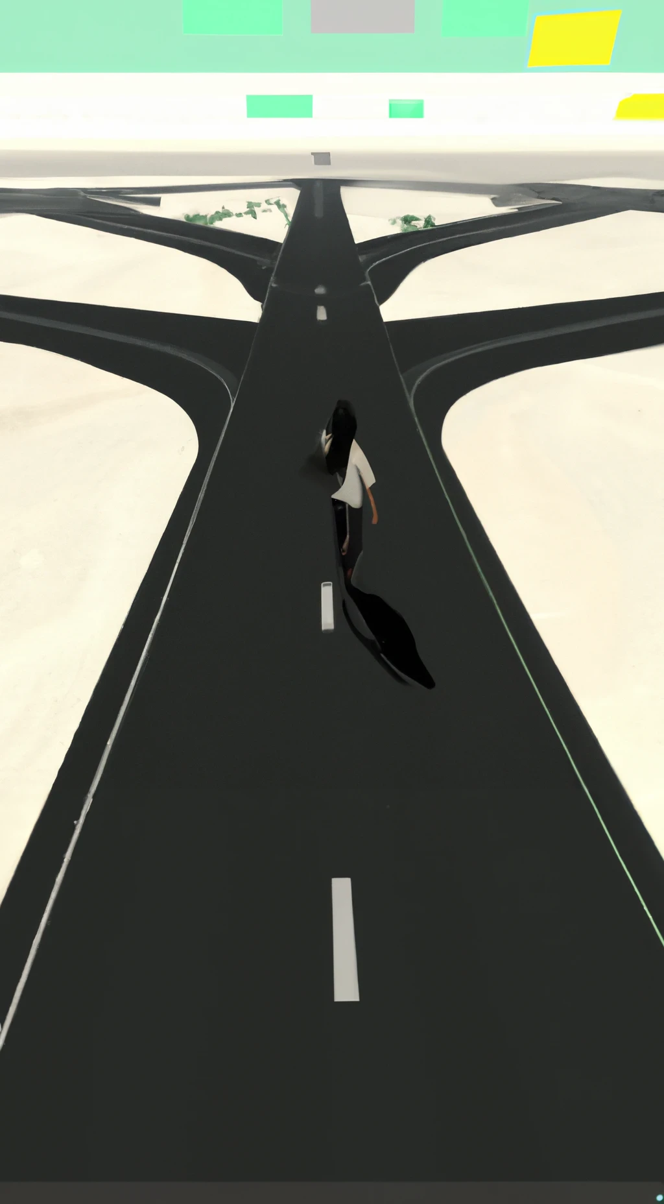

It all starts with…
←
→
Boundary-Based Segmentation
Object Classification
You Are Now Leaving
Pixel Classification

Slide 6
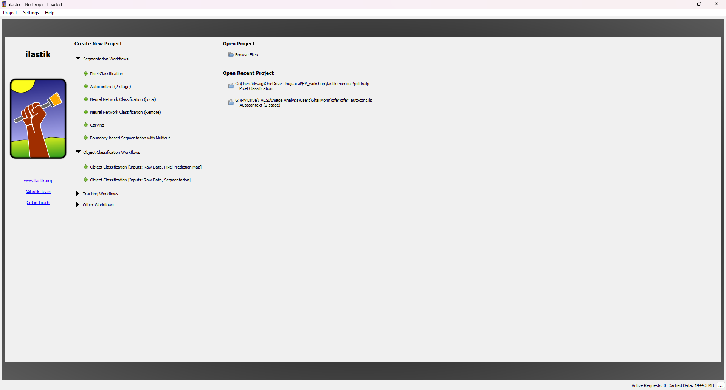
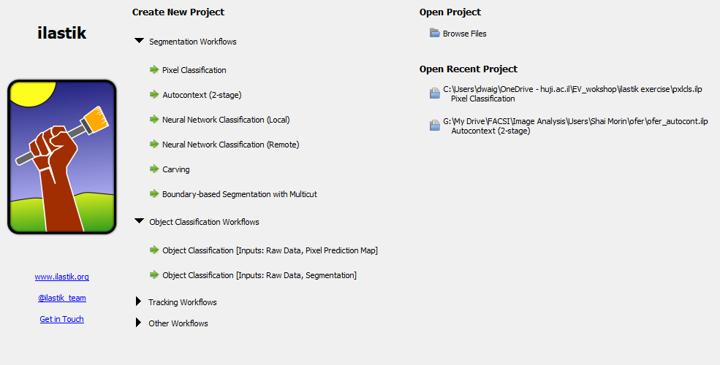
The GUI (Graphical User Interface)

Slide 7
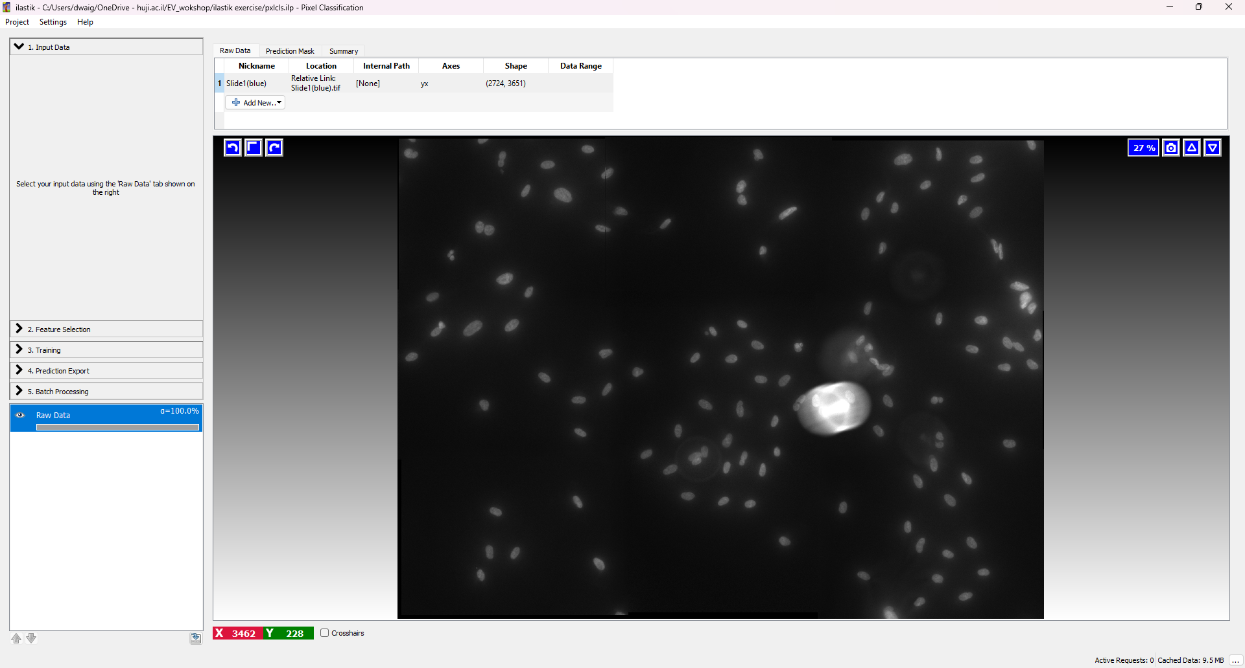
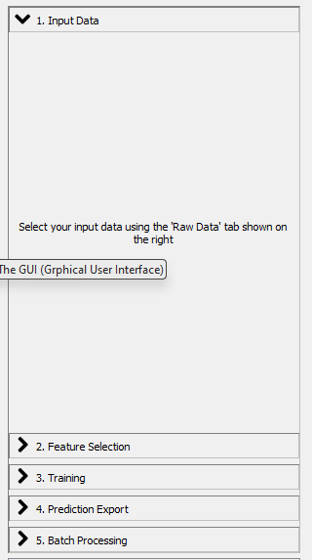
1. Input Data (2D/3D/3D+t)
And now, ‘.ome-zarr’
The preferred file format in ilastik is ‘.h5’/’.hdf5’. But, other file formats can be used, like ‘.tiff’, ‘.jpeg’, etc.

Slide 8
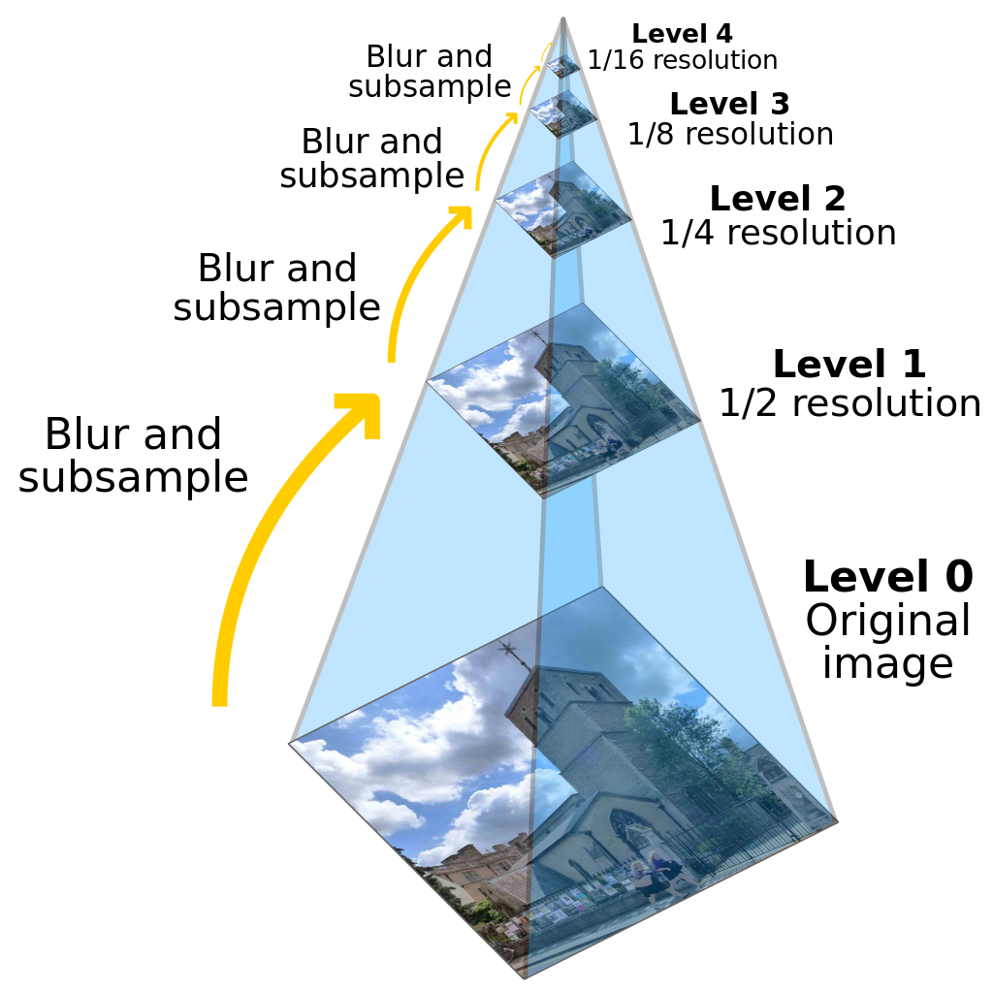
Why ‘.HDF5’?
This file format, Hierarchical Data Format (HDF), facilitates organized storage akin to a traditional directory structure, aiding in intuitive dataset management.
While HDF itself doesn't inherently support pyramid representation of images, it can store multi-resolution image datasets created externally. When zooming in/out in image analysis software, the appropriate resolution level can be loaded from the HDF file, enabling the software to process only the necessary pixels for the task at hand.
Less pixels = Less processing time, for the same task.
Pyramid (image processing) - Wikipedia

Slide 9
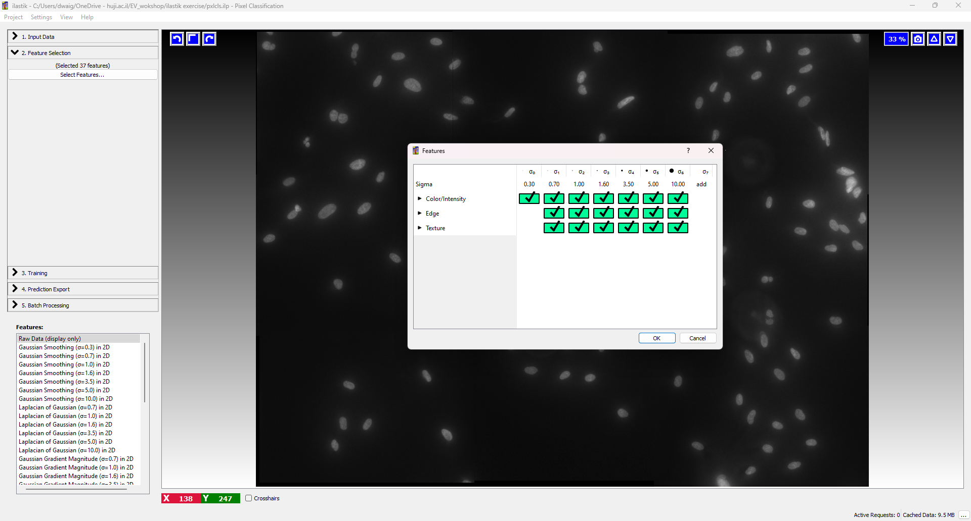
2. Feature Selection – Checkpoints in the ‘Random Forest’

Slide 10
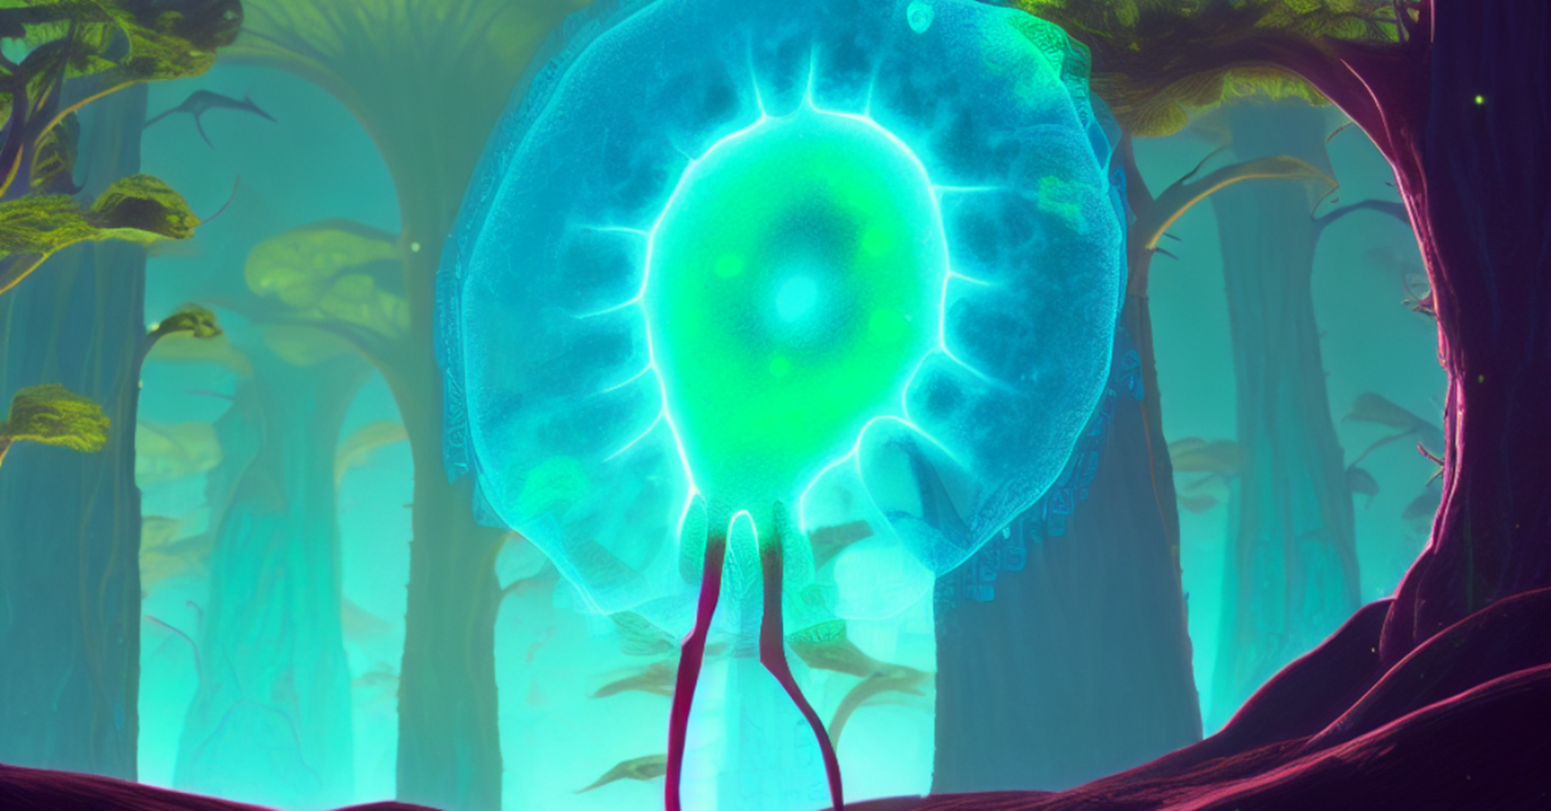
Random Forest in Ilastik – In short
Random Forest is a supervised learning algorithm that can be used for both classification and regression tasks. It operates by constructing multiple decision trees during training and outputting the class that is the mode of the classes from individual trees (classification) or mean prediction of the individual trees (regression).
In ilastik, the Random Forest algorithm is employed particularly in its interactive segmentation and classification workflows.
1. Training:
- Users provide a set of labeled examples (one or more images) by interactively marking pixels/regions belonging to different classes (e.g., object vs. background), avoid over fitting the classifier by using sparse annotation strategy.
- Random Forest learns from these labeled examples, “understanding” the patterns that define each class.
2. Prediction:
- Once trained, it can automatically classify the pixels in new, unlabeled images based on the learned patterns.
3. Feature Importance:
- Random Forest also provides insight into which features are most influential in making a classification,
which can be useful for object detection (optional - Automatic feature suggestion).
4. Iterative Refinement:
- Users can iteratively refine the model by providing additional labels, making the model more accurate over time.
Notes:
“ilastik lets you paint a few pixels, then the computer colours the rest.” Mention Random Forest only as the engine under the hood.
analogy: “Imagine asking 100 friends to vote on every pixel. The final colour is whatever most friends pick.”
“Export: save the probability map or labels as TIFF → analyse in Fiji or CellProfiler.” ilastik’s “pixel classification” in 4 steps
Paint a few examples of ‘what’s foreground’ and ‘what’s background’.
Random Forest votes on every pixel* and colours the rest for you.
Check the preview. If something looks wrong, add a couple more brush-strokes.
Export the result (label image or probability map) and measure it in Fiji, CellProfiler or Python.
<sub>Random Forest = a crowd of decision trees. Each tree gives an opinion; the majority wins. You don’t need the maths—just know ilastik uses this crowd to learn your patterns.</sub>
Speaker notes
Lead with a demo – open an image, scribble two colours, let ilastik “magically” segment.
Keep theory to one sentence: “RF is the engine, like a voting committee.”
Show the “Feature Selection” panel only if someone asks why their texture channel matters.
End with a flowchart: Image → ilastik → Label/Prob-map TIFF → Fiji/CP → Graphs/Stats.
Visual tweaks
Replace long paragraph with a pictogram: hand-drawn pixels → little decision trees → coloured prediction.
Use colour coding: green ticks for “what you do”, blue for “what ilastik does”.
Include a before/after thumbnail so the audience instantly sees the payoff.

Slide 11
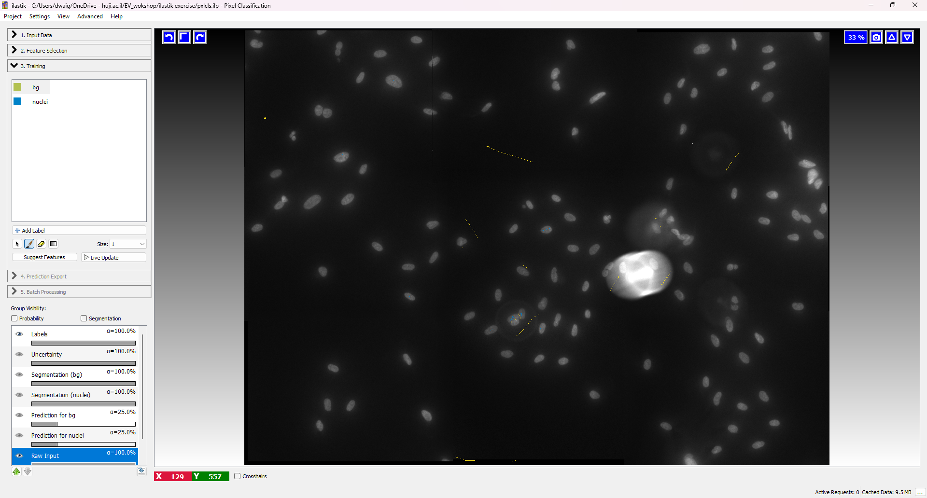
3. Training a pixel classifier
Classes
Tools
Visualization

Slide 12
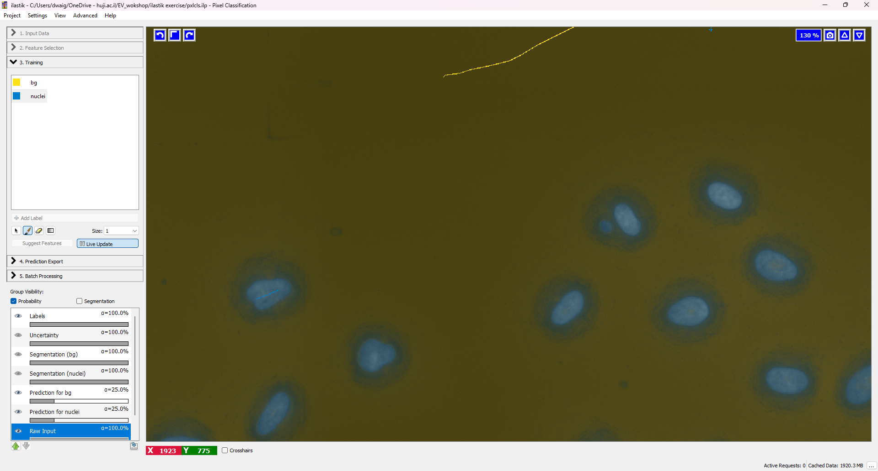
Class Predictions – Hotkey ‘P’

Slide 13
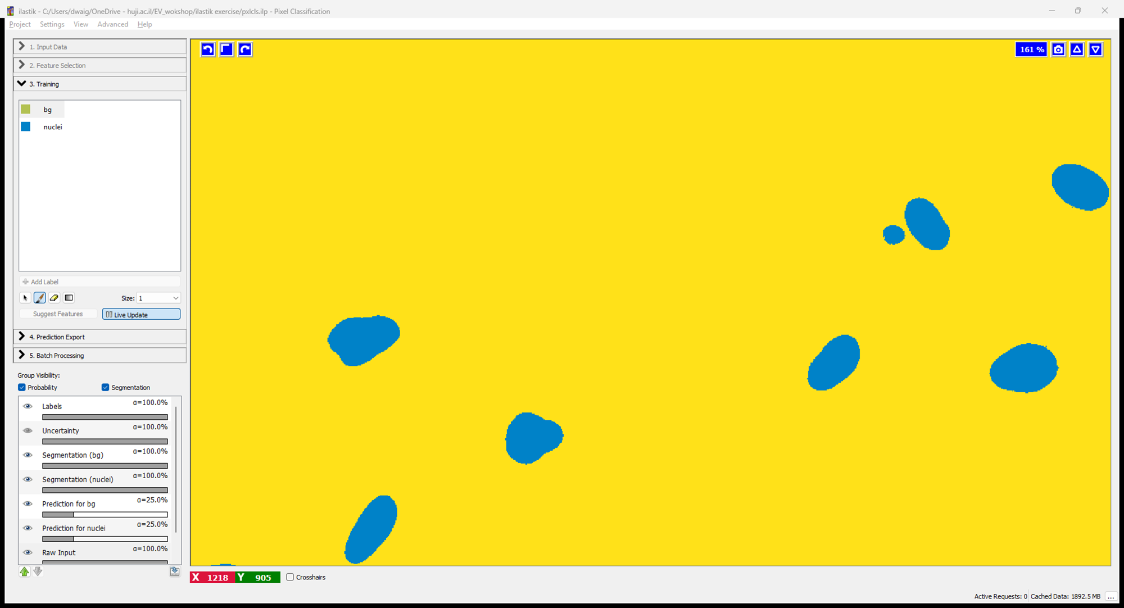
Class Segmentation – Hotkey ‘S’

Slide 14
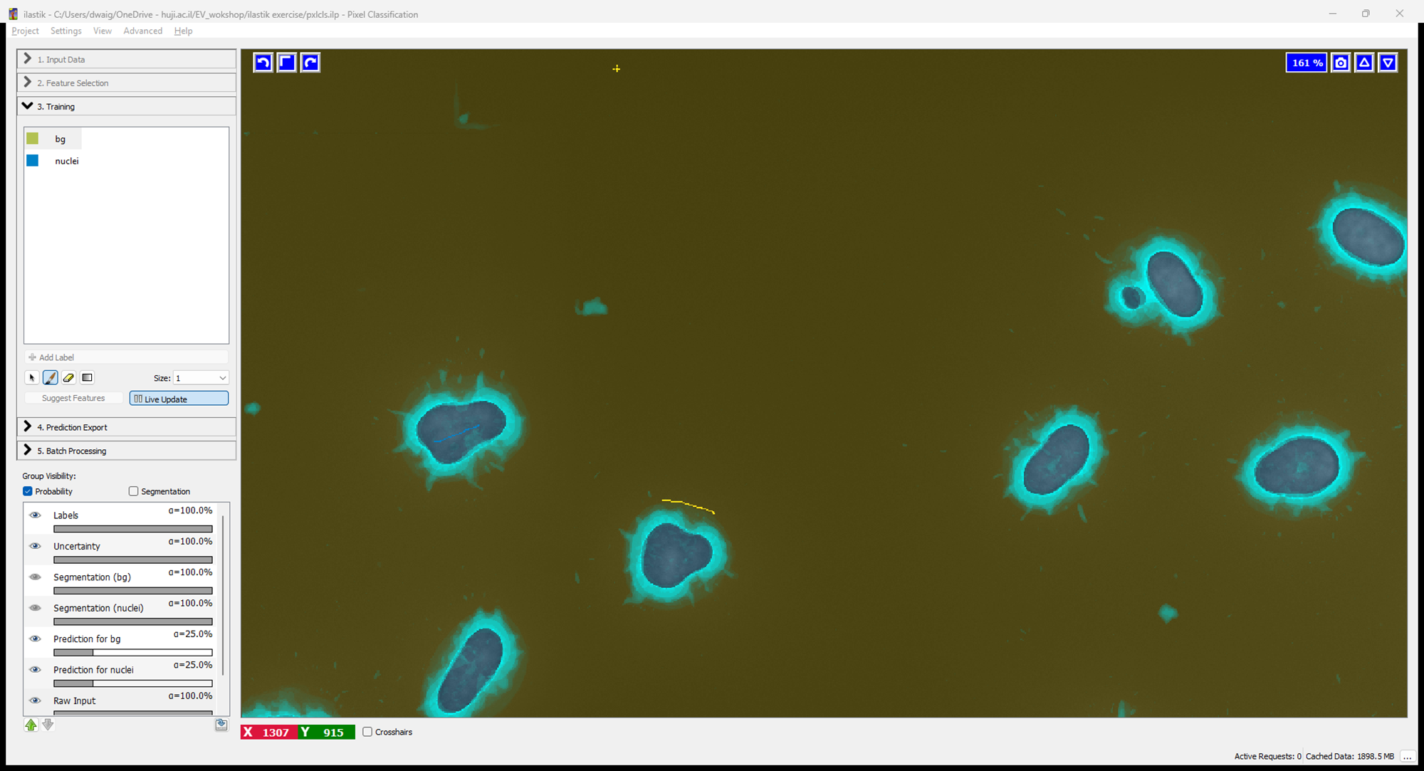
Class Uncertainty – Hotkey ‘U’

Slide 15
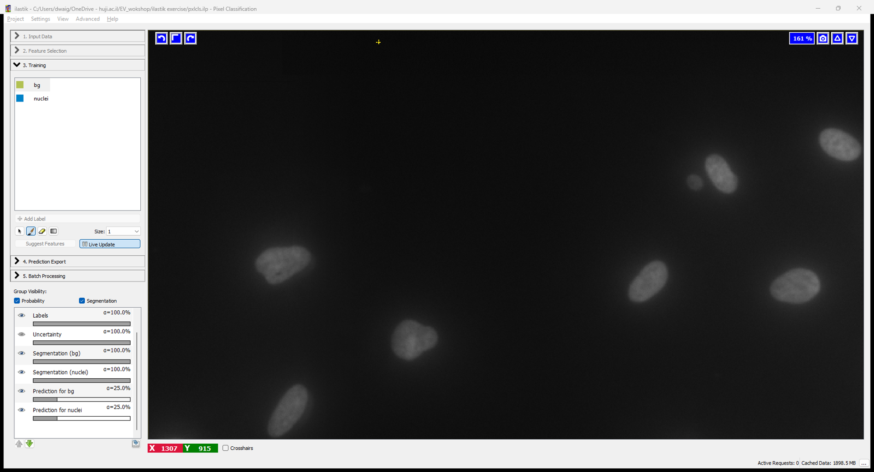
Raw Image – Hotkey ‘i’

Slide 16
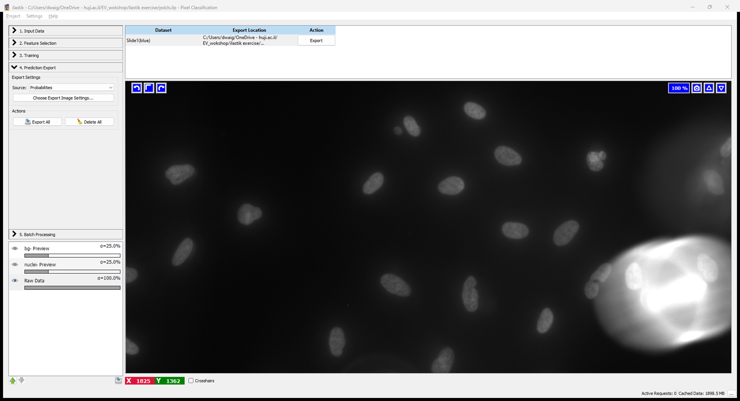
4. Prediction Export

Slide 17
4. Prediction Export

Slide 18
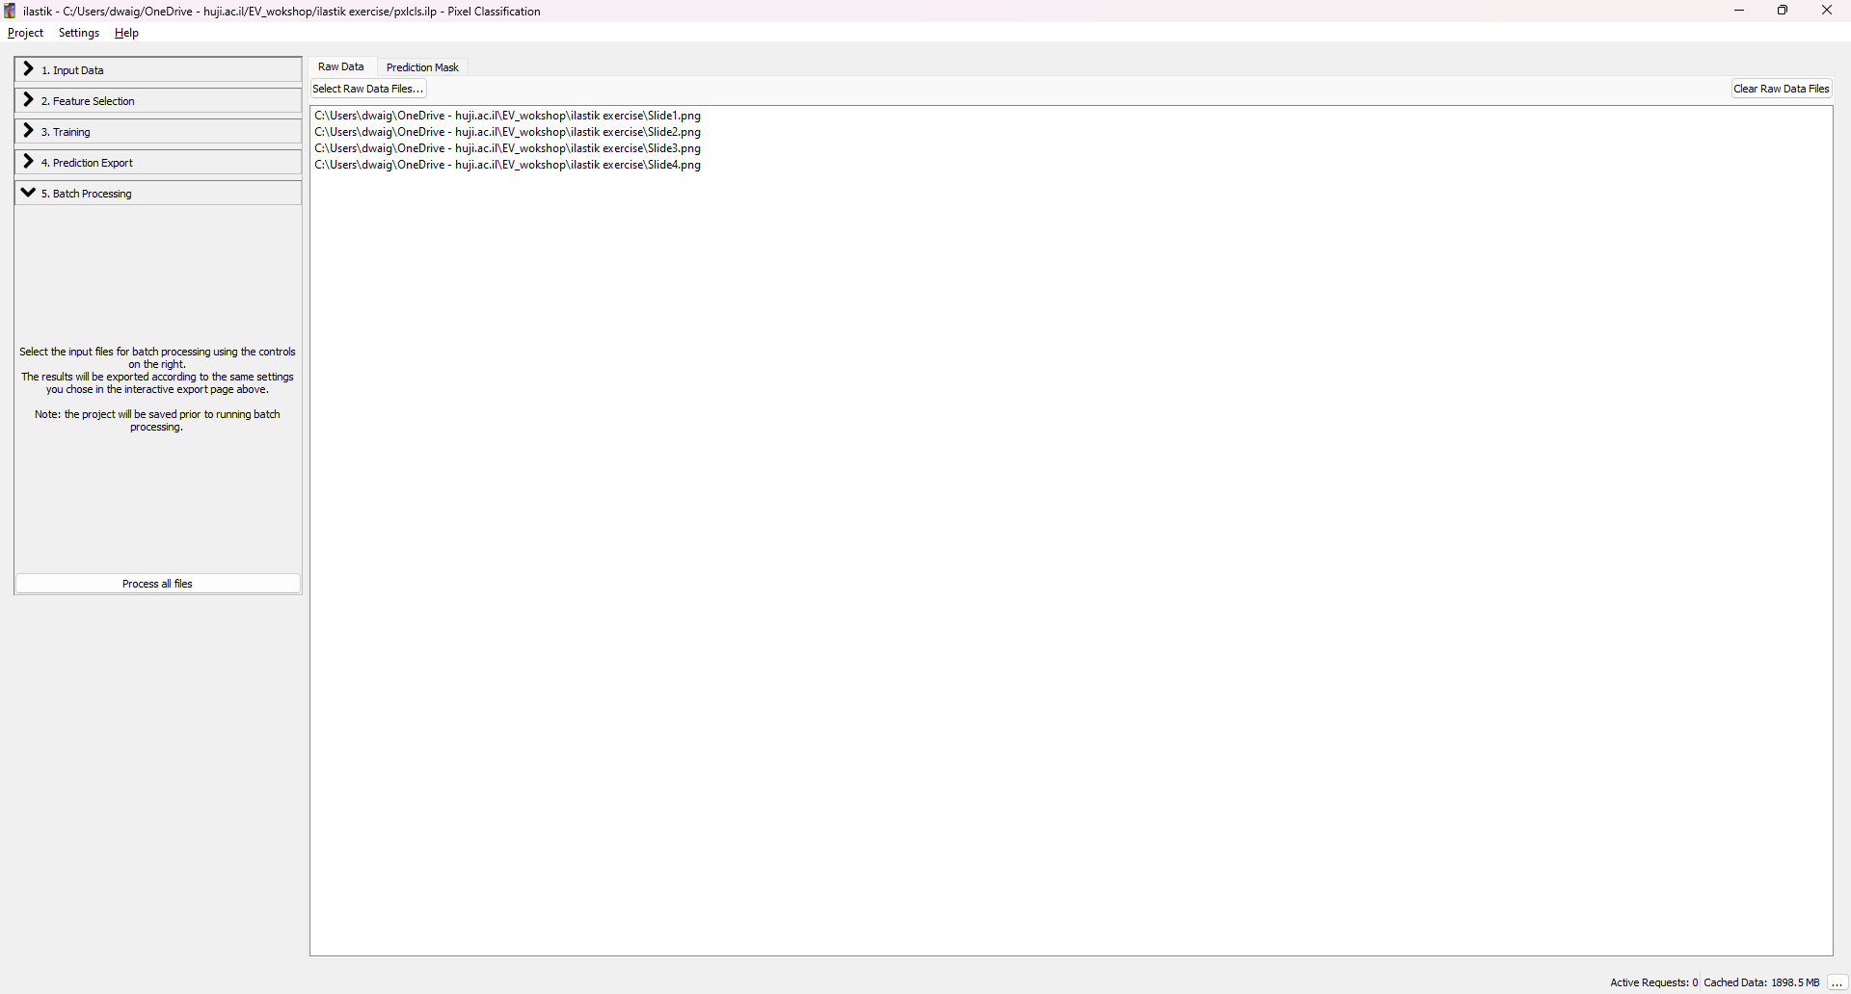
5. Batch Processing

Slide 19
Let’s try it ourselves!

